Slide 1
e-Portal for Case Management using Artificial Intelligence
PIP4004 Capstone Project
Review-2
Batch Number: ISE-09
Under the Supervision of,
Mr. Saptasi Sanyal
Assistant Professor
School of Computer Science and Engineering
Presidency University
Roll Number | Student Name
20211ISE0013 | Ananya T V
20211ISE0010 | Madan Gowda I M
20221LIE0003 | Dhangar Rakesh
Name of the Program: CSE
Name of the HoD: Dr. Pallavi R
Name of the Program Project Coordinator: Mr. Srinivas Mishra
Name of the School Project Coordinators: Dr. Sampath A K / Dr. Abdul Khadar A / Mr. Md Ziaur Rahman

Slide 2
Abstract
The judiciary system deals with various types of cases, including civil disputes and criminal trials, that require efficient management and strict adherence to procedures. Traditionally, handling these cases involves extensive paperwork, complex scheduling, and logistical challenges. These existing methods often lead to delays, high costs, limited accessibility, and inconsistent data management. To address these issues, we propose developing an online portal for case management and hearings. This e-portal aims to automate processes, reduce costs, improve accessibility, enhance transparency, and ensure consistent data management. By implementing this solution, we aim to expedite case resolutions, lower expenses, provide better access to information for all parties, and create a more efficient legal system.

Slide 3
Literature Survey
Author(s) | Year | Title | Key Findings
Abdul-Kader, K., & Woods, J. | 2015 | Design and Implementation of a Legal Case Management System | Explores the use of digital platforms for managing case files and improving judicial efficiency.
Yuan, Y., & Wang, T. | 2018 | Web-Based Court Case Tracking System | Discusses how online portals can help streamline case tracking and document retrieval.
Batra, D., & Singh, R | 2018 | Improving Efficiency of Legal Proceedings Using Digital Tools | Discusses the role of digitalization in improving the efficiency of court hearings and legal document handling.
Mahesh, B. P., & Kumar, N. | 2019 | Secure Cloud-Based Legal Document Management | . Reviews the importance of data security and cloud storage in legal e-portals.

Slide 4
Literature Survey
Suresh, V., & Rajan, M. | 2020 | AI-Powered Case Management Systems | Examines how AI and automation can assist in reducing manual workload in legal case handling.
Arora, P., & Ghosh, S. | 2020 | Designing an AI-Enabled Court Case Scheduling System | Proposes an AI-based scheduling system to optimize hearing dates and reduce backlog
Gupta, S., & Verma, R. | 2021 | Blockchain for Legal Case Management | Highlights how blockchain technology ensures transparency and immutability in court case records.
Zhang, H., & Li, A | 2021 | Digital Transformation of Judiciary through e-Governance | Examines government-led initiatives for digital case management and online hearings.
Patel, A., & Mehta, S. | 2021 | Enhancing Judicial Processes with e-Portals | Analyzes how digital platforms improve the accessibility of case hearings and case status updates.

Slide 5
Objectives
Develop an automated event extraction tool for legal case documents in Indian courts.
Focus on capturing the context surrounding extracted events and participants to enhance comprehension of legal cases.
Improve legal insights by providing meaningful and relevant insights from extracted events, aiding in trend identification.
Develop a natural language processing (NLP) system capable of understanding user queries in natural language.
Enable users to access the full PDF document directly from the search results.
Providing full summary of the pdf and then user can also sort documents based on relevance most recent or oldest.

Slide 6
Existing Methods - Drawbacks
Existing e-Portal case management systems that incorporate Artificial Intelligence offer many benefits, but they also come with several notable drawbacks. Here’s an overview of some key issues:
1. Transparency and Explainability
Black-Box Nature: Many AI models, especially those based on deep learning, operate as “black boxes.” This lack of transparency can make it difficult for users and decision-makers to understand how conclusions or recommendations are derived.
Accountability Challenges: In high-stakes scenarios—such as legal case management—this opaqueness can complicate efforts to audit decisions or explain outcomes to stakeholders.
2. Data Quality and Bias
Inconsistent Data Inputs: AI systems rely heavily on the quality of data. Inconsistent, incomplete, or poorly labeled data can lead to inaccurate analyses.

Slide 7
Drawbacks
Algorithmic Bias: If historical data contains biases, AI models may inadvertently perpetuate or even exacerbate these issues, leading to unfair or discriminatory outcomes.
3. Integration with Legacy Systems
Compatibility Issues: Many existing e-Portals are built on older technologies. Integrating advanced AI modules with these legacy systems can be complex and may require significant re-engineering.
Interoperability Concerns: Ensuring seamless communication between new AI components and existing workflows can be challenging, often leading to system inefficiencies.
4. Security and Privacy Concerns
Data Vulnerability: Case management systems handle sensitive and confidential information. The introduction of AI increases the attack surface, potentially exposing data to breaches.

Slide 8
Drawbacks
Compliance Risks: Ensuring that AI-driven processes adhere to strict data protection regulations (like GDPR or HIPAA) adds another layer of complexity to system management.
5. High Cost and Maintenance Complexity
Implementation Expense: Deploying AI solutions often requires substantial upfront investment, including hardware, software, and skilled personnel.
Ongoing Maintenance: AI systems need regular updates and continuous monitoring to maintain accuracy and reliability, which can be resource-intensive.
6. Regulatory and Ethical Challenges
Compliance with Standards: In sectors like legal and public administration, decisions made or assisted by AI must meet rigorous regulatory standards. Ensuring this compliance can be difficult when the AI’s decision-making process is not fully transparent.

Slide 9
Drawbacks
Ethical Implications: There’s an ongoing debate about the ethics of automating critical decisions. Over-reliance on AI might sideline human judgment, raising concerns about accountability and fairness.
7. User Adoption and Trust
Resistance to Change: Stakeholders may be reluctant to trust or adopt AI-driven systems, particularly if they do not understand how decisions are made.
Training Requirements: Effective use of AI-enhanced portals requires that users receive proper training, which can delay full-scale implementation and acceptance.
8. Limited Contextual Understanding
Handling Edge Cases: AI models typically perform well on data they’ve been trained on, but may struggle with novel or nuanced cases that fall outside standard patterns.
Overgeneralization: Without human oversight, there’s a risk that the AI might not fully capture the unique circumstances of individual cases, leading to generic or inappropriate solutions.

Slide 10
Proposed Method
The development of the e-Portal for Case Management Hearing follows these key steps:
Web-Based Platform Development – Using React.js and Next.js for a responsive interface.
User Authentication System – Secure login with OAuth 2.0 for role-based access.
Database Integration – PostgreSQL used for structured case record storage.
Automated Notifications – Email & SMS alerts for case hearings and status updates.
Case Tracking & Scheduling – AI-powered system for hearing scheduling optimization.
Security Measures – Data encryption and role-based access control for secure legal data management.

Slide 11
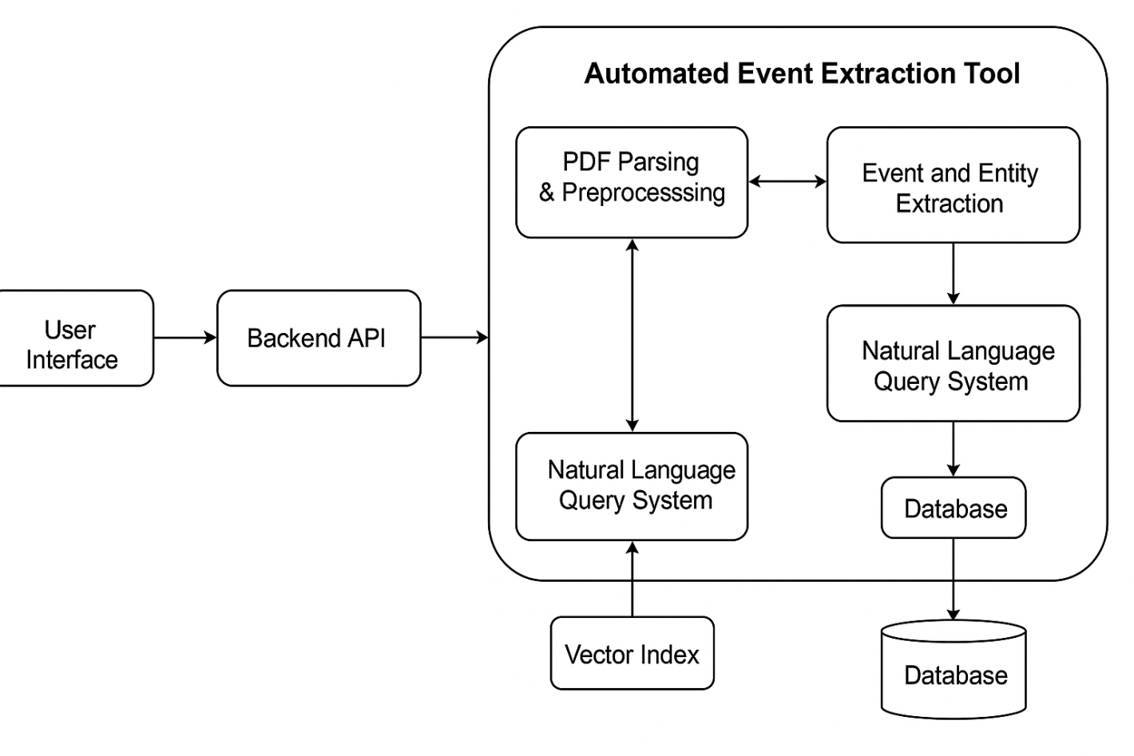
Architecture Diagram
Here this diagram explains the architecture of an Automated Event Extraction Tool, designed to process PDFs, extract information, and enable natural language queries. It includes some component, they are:
User Interface: The entry point where users interact with the system (e.g., upload PDFs or input queries).
Backend API: Acts as a bridge between the user interface and the core processing components of the tool.
Database: Stores structured data extracted from the documents for efficient querying.

Slide 12
contt
Automated Event Extraction Tool: The main system comprising the following modules:
PDF Parsing & Preprocessing: Extracts text and prepares the content from PDF files for further analysis.
Event and Entity Extraction: Identifies events and entities from the parsed text using NLP techniques.
Natural Language Query System: Allows users to query the extracted data using plain language. There are two query paths:
One processes data from PDFs via the preprocessing stage.
The other accesses a Database storing pre-extracted events/entities.
Vector Index: Stores vector representations of the documents or entities for semantic search and fast retrieval in response to user queries.

Slide 13
Modules
Technology Stack Components:
Frontend:
React.js / Angular for user interface
Bootstrap / Material UI for responsive design
Backend:
Node.js / Django for server-side logic
PostgreSQL / MongoDB for case data storage
Additional Technologies:
WebRTC / Zoom API for virtual hearings
JWT for authentication and security

Slide 14
Hardware & Software Details
Software and Hardware Requirements:
Operating System: Windows / Linux for deployment
Database: Cloud-based storage for legal documents
Security: Encryption, role-based access control
Development Tools: VS Code, GitHub, Postman for API testing

Slide 15
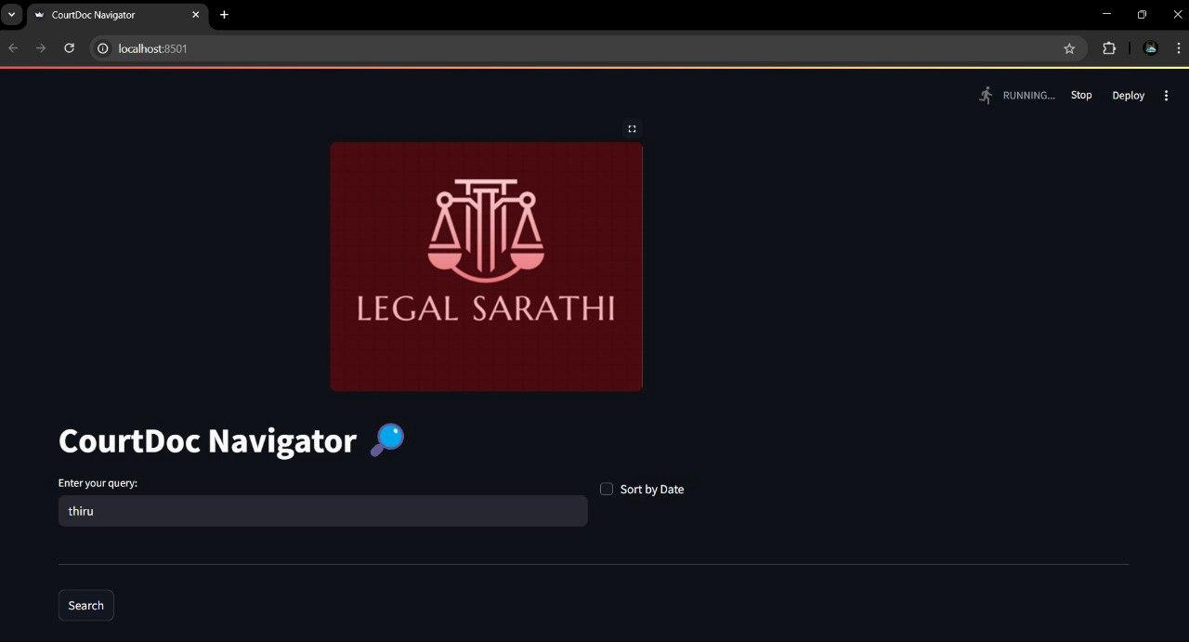

Prototype (Screenshots)
Interface of the e-portal : The application serves as a central hub for storing and displaying case-related documents. It allows users to search for specific cases using keywords and view the relevant legal files. This streamlines access to important case information in a structured and efficient way. Users can also sort results by date, making it easier to track the progression of a case over time. Designed with a user-friendly interface, the platform simplifies legal document navigation for both professionals and the general public.

Slide 16

The application serves as a centralized platform where all case-related documents are stored and made accessible to users. It allows users to easily search, retrieve, and view legal documents associated with various court cases. By entering specific queries, users can locate relevant information efficiently, and the system can display results sorted by relevance or date. This functionality ensures that legal professionals, researchers, or individuals involved in cases can quickly find and access important case files and records in one organized location.

Slide 17
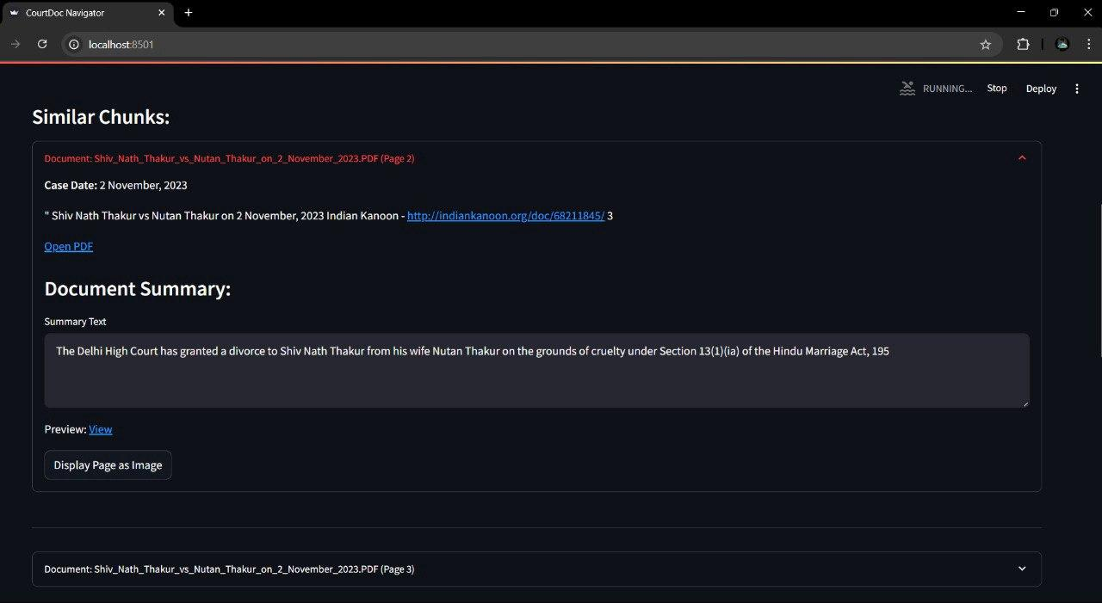
User Query and Document Summary enhances application usability by allowing users to enter natural language queries—such as case names, keywords, or phrases—and receive concise summaries of relevant legal documents. This helps users quickly understand key content without reading full texts, greatly improving efficiency for legal professionals and researchers handling large volumes of information.

Slide 18
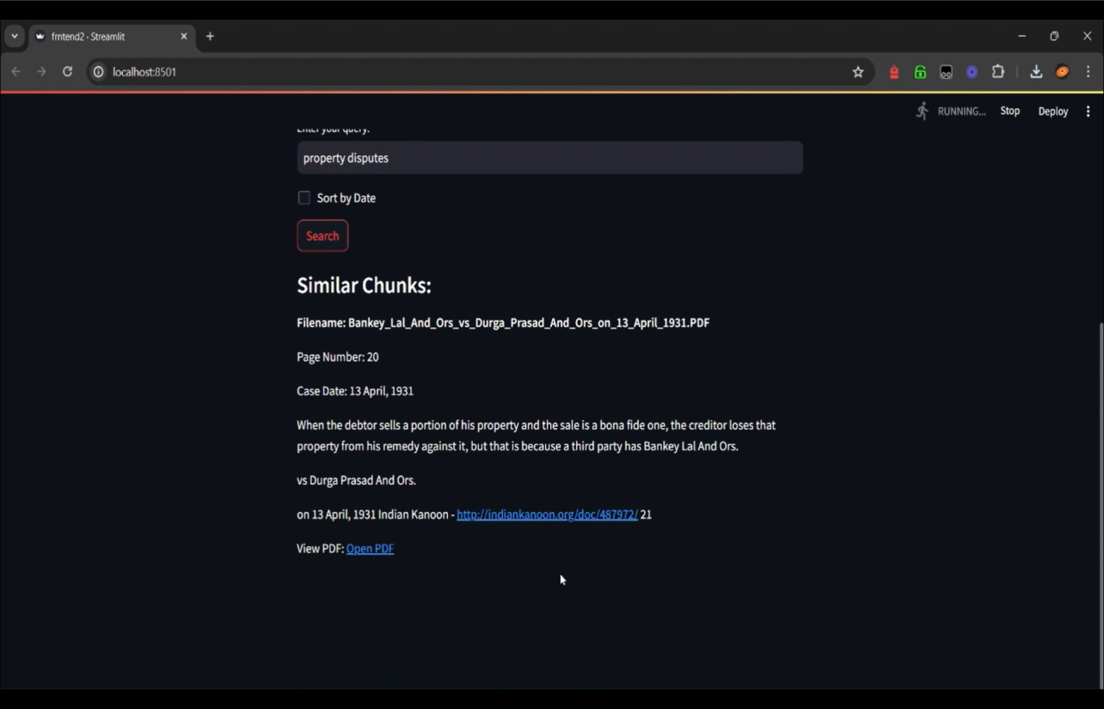
Case Description Information provides users with a brief overview of individual legal cases, including essential details like parties involved, case type, and key events. This feature allows users to quickly grasp the context and significance of a case without reviewing the full document, streamlining legal research and analysis.

Slide 19
Github Link
GitHub Link
Description:
Development of e-Portal for facilitating Case Management Hearing of various
types of cases

Slide 20
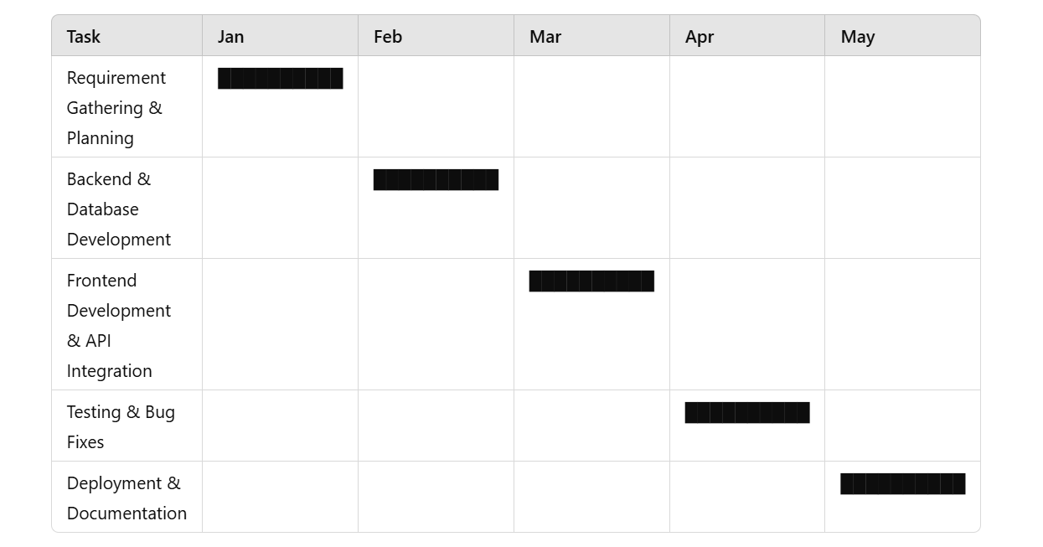
Timeline of the Project
Gantt Chart:

Slide 21
References
Abdul-Kader, K., & Woods, J. (2015) - Digital Legal Case Management Systems
→ Discusses how web-based platforms improve efficiency in managing legal cases and court documents.
Yuan, Y., & Wang, T. (2018) - AI in Judiciary Portals
→ Explores the role of AI in improving case tracking, decision-making, and automating legal workflows.
Suresh, V., & Rajan, M. (2020) - Automation in Court Hearings
→ Highlights how automating judicial processes reduces delays and optimizes hearing schedules.
Patel, A., & Mehta, S. (2021) - e-Governance in Judiciary
→ Examines how digital case tracking systems enhance accessibility and transparency in courts.
Mahesh, B. P., & Kumar, N. (2019) - Cloud-Based Legal Data Management
→ Analyzes the importance of secure cloud storage for handling large volumes of legal case data.
Batra, D., & Singh, R. (2018) - Smart Legal Case Processing
→ Discusses how technology-driven legal case improves workflow and reduces human effort.

Slide 22
References
Batra, D., & Singh, R. (2018) - Smart Legal Case Processing
→ Discusses how technology-driven legal case management improves workflow and reduces human effort.
Gupta, S., & Verma, R. (2021) - Blockchain in Case Management
→ Investigates how blockchain ensures data integrity, security, and transparency in legal records.
Arora, P., & Ghosh, S. (2020) - AI-Powered Case Scheduling
→ Demonstrates how AI-based scheduling systems help reduce case backlog and improve efficiency.
Zhang, H., & Li, A. (2021) - Digital Transformation in Judiciary
→ Studies how governments worldwide are implementing e-Governance solutions for legal case management.
Sharma, M., & Joseph, T. (2020) - Predictive Analytics in Law
→ Explains how AI and data analytics help predict case outcomes and assist legal professionals.

Slide 23


